Slide 1
The Muscular System:
Part C
10

Slide 2
Muscles Crossing the Shoulder Joint
Nine muscles cross shoulder joint; insert on and move humerus
Some originate from scapula; others from axial skeleton
Actions include flexion, extension, adduction

Slide 3
Muscles Crossing the Shoulder Joint
Three prime movers of arm
  Pectoralis major
  Latissimus dorsi
  Deltoid

Slide 4
Muscles Crossing the Shoulder Joint
PLAY
A&P Flix™: Pectoralis major
PLAY
A&P Flix™: Latissimus dorsi
PLAY
A&P Flix™: Deltoid

Slide 5
Muscles Crossing the Shoulder Joint
Rotator cuff muscles act as synergists and fixators; originate on scapula; reinforce shoulder capsule; prevent dislocation
  Supraspinatus
  Infraspinatus
  Teres minor
  Subscapularis
Coracobrachialis and teres major - synergists

Slide 6
Muscles Crossing the Shoulder Joint
PLAY
A&P Flix™: Muscles that cross the glenohumeral joint
PLAY
A&P Flix™: Movement from the rotator cuff muscles (a)
PLAY
A&P Flix™: Movement from the rotator cuff muscles (b)
PLAY
A&P Flix™: Teres Major

Slide 7
Rotator Cuff Anatomy and Function
PLAY
A&P Flix™: Subscapularis
PLAY
A&P Flix™: Supraspinatus
PLAY
A&P Flix™: Infraspinatus
PLAY
A&P Flix™: Teres minor
PLAY
A&P Flix™: Rotator cuff muscles

Slide 8
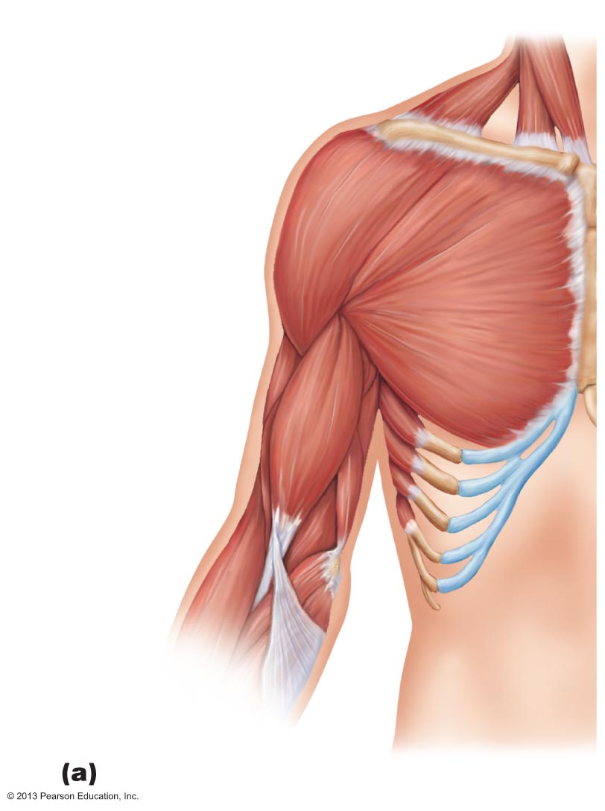
Figure 10.15a Muscles crossing the shoulder and elbow joints, causing movements of the arm and forearm, respectively.
Clavicle
Deltoid
Sternum
Pectoralis
major
Coracobrachialis
Triceps brachii:
Lateral head
Long head
Medial head
Biceps
brachii
Brachialis
Brachio-
radialis
Anterior view

Slide 9
Rotator Cuff Anatomy and Function
PLAY
A&P Flix™: Scapular muscles of the glenohumeral joint (a)
PLAY
A&P Flix™: Axial muscles of the glenohumeral joint (a)

Slide 10
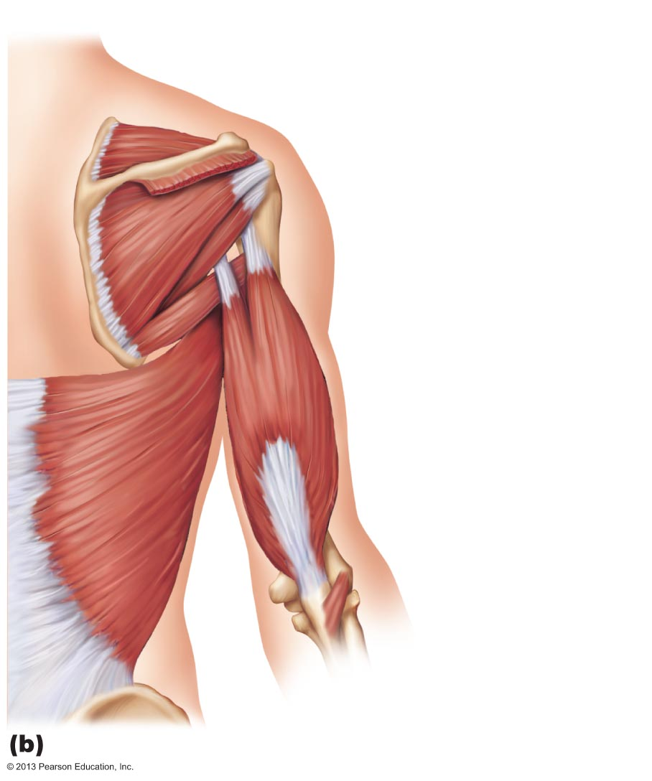
Figure 10.15b Muscles crossing the shoulder and elbow joints, causing movements of the arm and forearm, respectively.
Supraspinatus*
Spine of scapula
Deltoid (cut)
Greater tubercle
of humerus
Infraspinatus*
Teres minor*
Teres major
Triceps brachii:
Lateral head
Long head
Latissimus dorsi
Humerus
Olecranon
of ulna
Anconeus
Posterior view

Slide 11
Rotator Cuff Anatomy and Function
PLAY
A&P Flix™: Scapular muscles of the glenohumeral joint (b)
PLAY
A&P Flix™: Axial muscles of the glenohumeral joint (b)

Slide 12
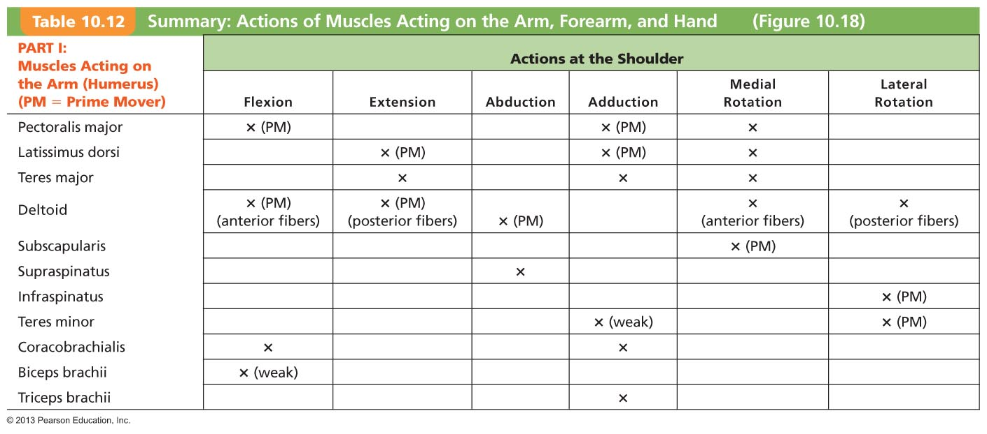
Table 10.12 Summary: Actions of Muscles Acting on the Arm, Forearm, and Hand (1 of 3)

Slide 13
Movement at the Glenohumeral Joint
PLAY
A&P Flix™: Movement at the glenohumeral joint: An overview
PLAY
A&P Flix™: Movement at the glenohumeral joint (a)
PLAY
A&P Flix™: Movement at the glenohumeral joint (b)

Slide 14
Muscles Crossing the Elbow Joint
Anterior flexor muscles
  Brachialis and biceps brachii—chief forearm flexors
  Brachioradialis—synergist and stabilizer
PLAY
A&P Flix™: The elbow joint and forearm: An overview
PLAY
A&P Flix™: Muscles of the elbow joint (a)

Slide 15
Figure 10.15a Muscles crossing the shoulder and elbow joints, causing movements of the arm and forearm, respectively.
Clavicle
Deltoid
Sternum
Pectoralis
major
Coracobrachialis
Triceps brachii:
Lateral head
Long head
Medial head
Biceps
brachii
Brachialis
Brachio-
radialis
Anterior view

Slide 16
Muscles Crossing the Elbow Joint
PLAY
A&P Flix™: Muscles of the elbow joint (b)
PLAY
A&P Flix™: Biceps brachii
PLAY
A&P Flix™: Brachialis
PLAY
A&P Flix™: Brachioradialis

Slide 17
Muscles Crossing the Elbow Joint
Posterior extensor muscles
  Triceps brachii—prime mover of forearm extension
  Anconeus—weak synergist

Slide 18
Figure 10.15b Muscles crossing the shoulder and elbow joints, causing movements of the arm and forearm, respectively.
Supraspinatus*
Spine of scapula
Deltoid (cut)
Greater tubercle
of humerus
Infraspinatus*
Teres minor*
Teres major
Triceps brachii:
Lateral head
Long head
Latissimus dorsi
Humerus
Olecranon
of ulna
Anconeus
Posterior view

Slide 19
Muscles Crossing the Elbow Joint
PLAY
A&P Flix™: Muscles of the elbow joint (c)
PLAY
A&P Flix™: Triceps brachii

Slide 20
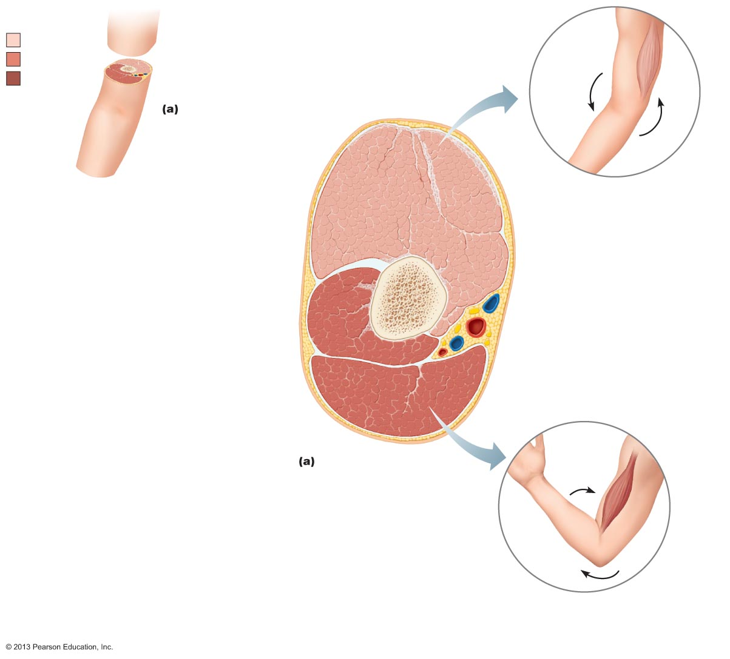
Figure 10.18a Summary: Actions of muscles of the arm and forearm.
Key:
Extensors
Flexors
Others
Lateral
head
Long
head
Posterior compartment of arm
(extends elbow); innervated by
radial nerve
Triceps
brachii
Medial
head
Humerus
Brachialis
Short head
Biceps brachii
Long head
Muscles of the arm
PLAY
A&P Flix™: Movement at the elbow joint
Anterior compartment of arm
(flexes elbow); innervated by
musculocutaneous nerve

Slide 21
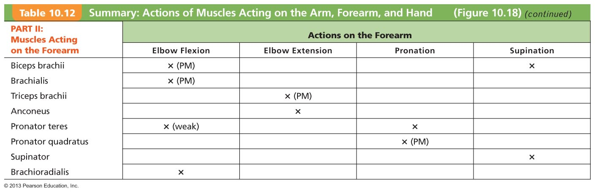
Table 10.12 Summary: Actions of Muscles Acting on the Arm, Forearm, and Hand (2 of 3)

Slide 22
Muscles of the Forearm
Actions - movements of wrist, fingers, thumb, pronation, supination
Most anterior muscles – flexors; insert via flexor retinaculum
Most posterior muscles – extensors; insert via extensor retinaculum
PLAY
A&P Flix™: Muscles that act on the wrist
and fingers: An overview
PLAY
A&P Flix™: Muscles of the forearm (a)

Slide 23
Muscles of the Forearm
Pronator teres and pronator quadratus pronate forearm
Supinator - synergist with biceps brachii in forearm supination
PLAY
A&P Flix™: Muscles of the forearm (b)
PLAY
A&P Flix™: Muscles of the forearm (c)
PLAY
A&P Flix™: Pronator teres
PLAY
A&P Flix™: Supinator

Slide 24
Muscles of the Forearm: Anterior Compartment
Flexors
  Flexor carpi radialis
  Palmaris longus
  Flexor carpi ulnaris
  Flexor digitorum superficialis and flexor digitorum profundus
  Flexor pollicis longus
PLAY
A&P Flix™: Carpal tunnel

Slide 25
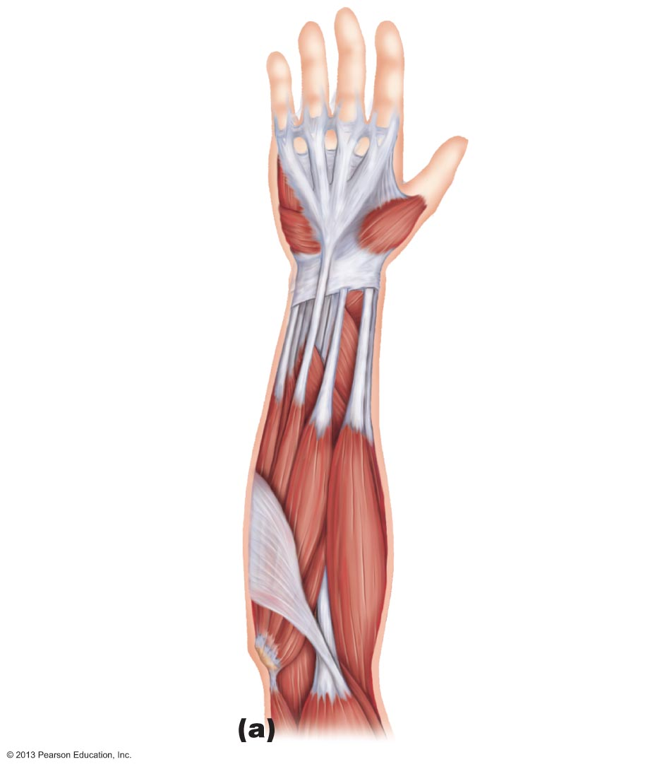
Figure 10.16a Muscles of the anterior fascial compartment of the forearm acting on the right wrist and fingers.
Superficial
transverse
ligament of palm
Palmar
aponeurosis
Flexor
retinaculum
Flexor
digitorum
superficialis
Pronator
quadratus
Flexor pollicis
longus
Flexor carpi
ulnaris
Palmaris
longus
Extensor carpi
radialis longus
Flexor
carpi radialis
Brachio-
radialis
Medial
epicondyle
of humerus
Pronator
teres
Tendon of
biceps brachii
Medial head of
triceps brachii
Biceps brachii

Slide 26
Muscles of the Forearm: Anterior Compartment
PLAY
A&P Flix™: Anterior Muscles of the wrist and fingers (b)
PLAY
A&P Flix™: Flexor carpi radialis
PLAY
A&P Flix™: Flexor carpi ulnaris
PLAY
A&P Flix™: Flexor digitorum superficialis

Slide 27
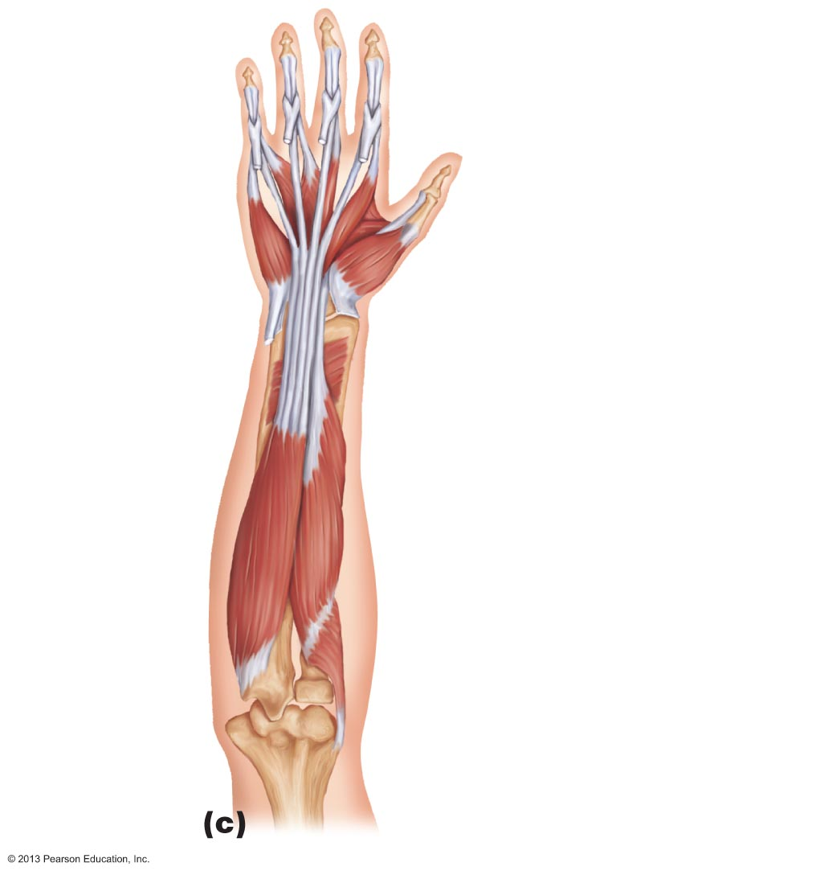
Figure 10.16c Muscles of the anterior fascial compartment of the forearm acting on the right wrist and fingers.
Tendon of flexor
digitorum superficialis
(cut)
Tendon of
flexor digitorum
profundus
Lumbricals
Tendon of flexor
pollicis longus
Thenar muscles
of thumb
Tendon of
flexor carpi ulnaris
(cut)
Pronator quadratus
Flexor pollicis
longus
Flexor digitorum
profundus
Supinator

Slide 28
Muscles of the Forearm: Anterior Compartment
PLAY
A&P Flix™: Anterior Muscles of the wrist and fingers (a)

Slide 29
Muscles of the Forearm: Posterior Compartment
Extensors
  Extensor carpi radialis longus and brevis
  Extensor digitorum
  Extensor carpi ulnaris
  Extensor pollicis brevis and longus
  Extensor indicis
  Abductor pollicis longus

Slide 30
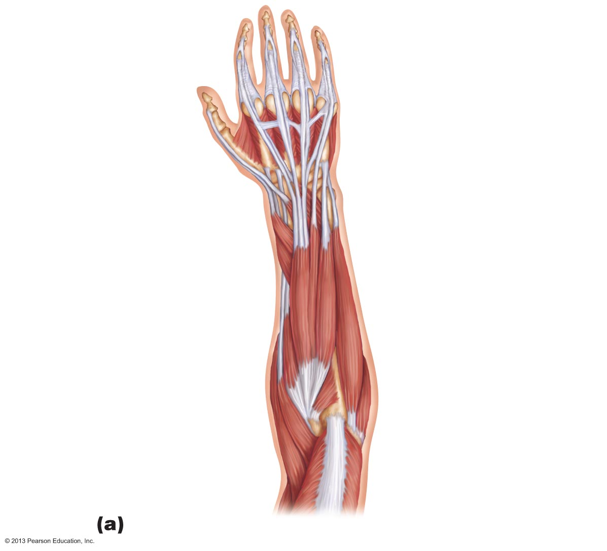
Figure 10.17a Muscles of the posterior fascial compartment of the right forearm acting on the wrist and fingers.
Extensor expansion
Tendons of extensor
digitorum
Tendons of extensor
carpi radialis brevis
and longus
Extensor pollicis
longus
Extensor indicis
Extensor pollicis
brevis
Extensor digiti minimi
Abductor
pollicis longus
Extensor carpi
ulnaris
Extensor digitorum
Flexor carpi ulnaris
Extensor carpi
radialis brevis
Anconeus
Extensor carpi
radialis longus
Insertion of
triceps brachii
Brachioradialis

Slide 31
Muscles of the Forearm: Posterior Compartment
PLAY
A&P Flix™: Posterior Muscles of the wrist and fingers (b)
PLAY
A&P Flix™: Extensor carpi radialis longus
PLAY
A&P Flix™: Extensor carpi radialis brevis
PLAY
A&P Flix™: Extensor digitorum
PLAY
A&P Flix™: Extensor carpi ulnaris(c)

Slide 32
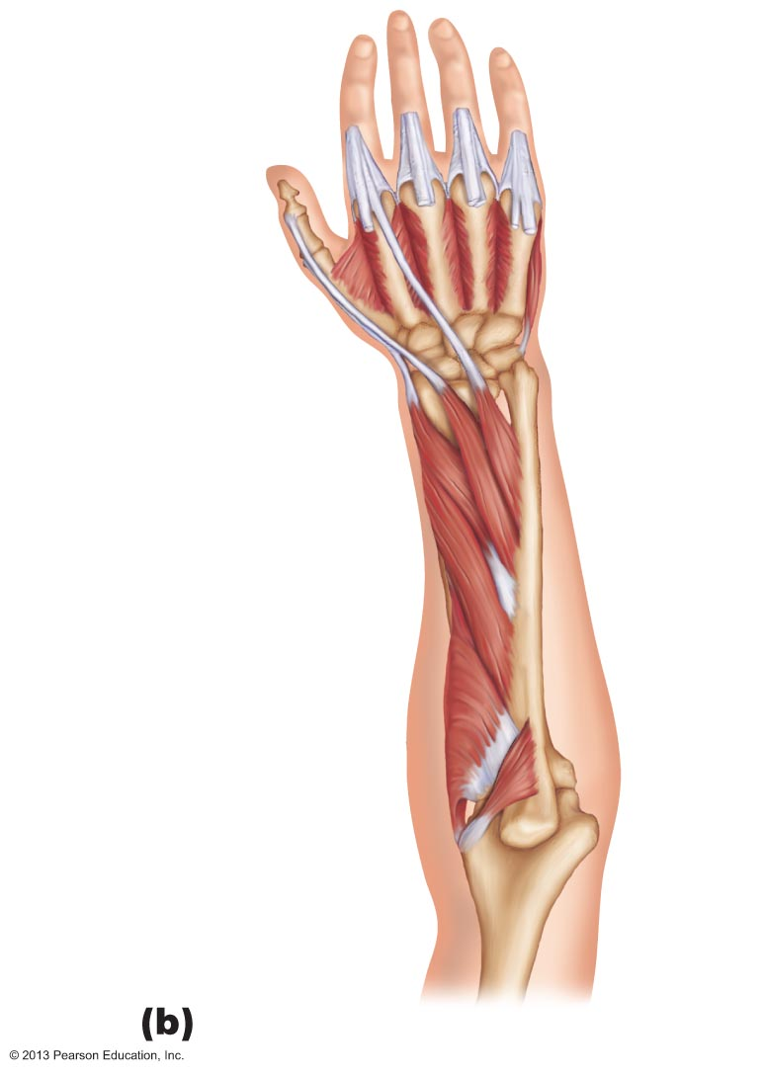
Figure 10.17b Muscles of the posterior fascial compartment of the right forearm acting on the wrist and fingers.
Interossei
Extensor indicis
Extensor pollicis
brevis
Extensor pollicis
longus
Abductor pollicis
longus
Supinator
Anconeus
Olecranon of ulna

Slide 33
Muscles of the Forearm: Posterior Compartment
PLAY
A&P Flix™: Posterior Muscles of the wrist and fingers (a)

Slide 34
Movements of the Wrist and Fingers
Flexion and extension
Abduction and adduction
PLAY
A&P Flix™: Movements of the wrist and fingers (a)
PLAY
A&P Flix™: Movements of the wrist and fingers (b)

Slide 35
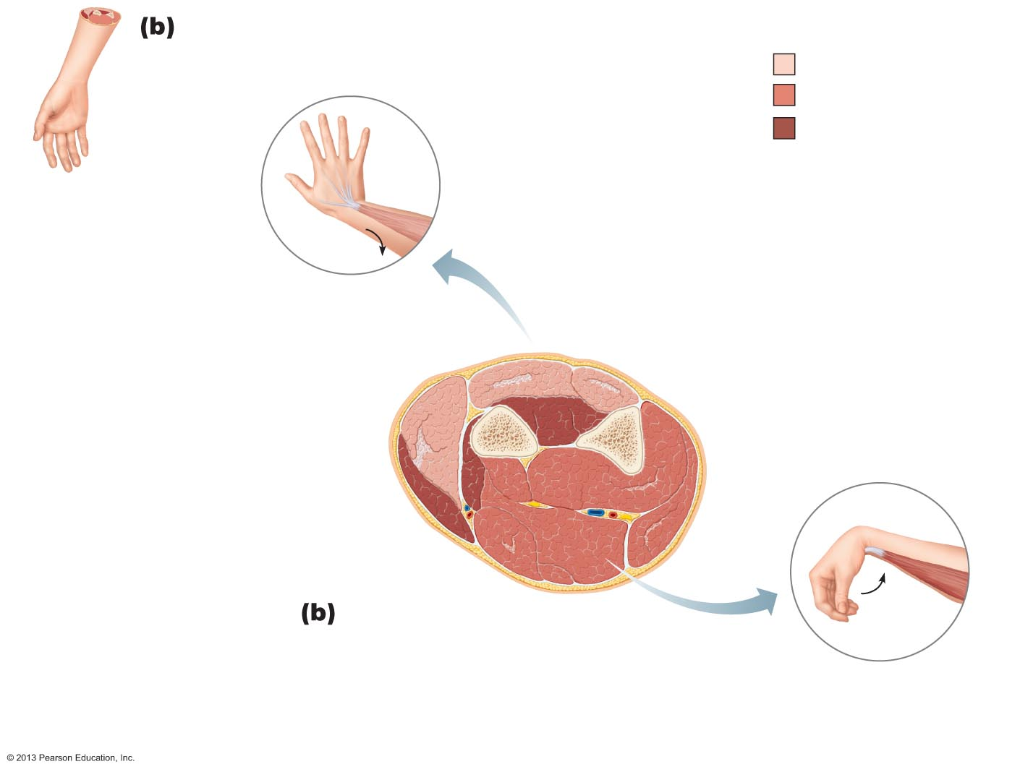
Figure 10.18b Summary: Actions of muscles of the arm and forearm.
Key:
Extensors
Flexors
Others
Posterior compartment of forearm
(extends wrist and fingers);
innervated by radial nerve
Extensors
Radius
Abductor
pollicis longus
Ulna
Others
Pronator teres
Brachioradialis
(elbow flexor)
Flexors
Muscles of the forearm
Anterior compartment of forearm
(flexes wrist and fingers);
innervated by median or ulnar nerve

Slide 36
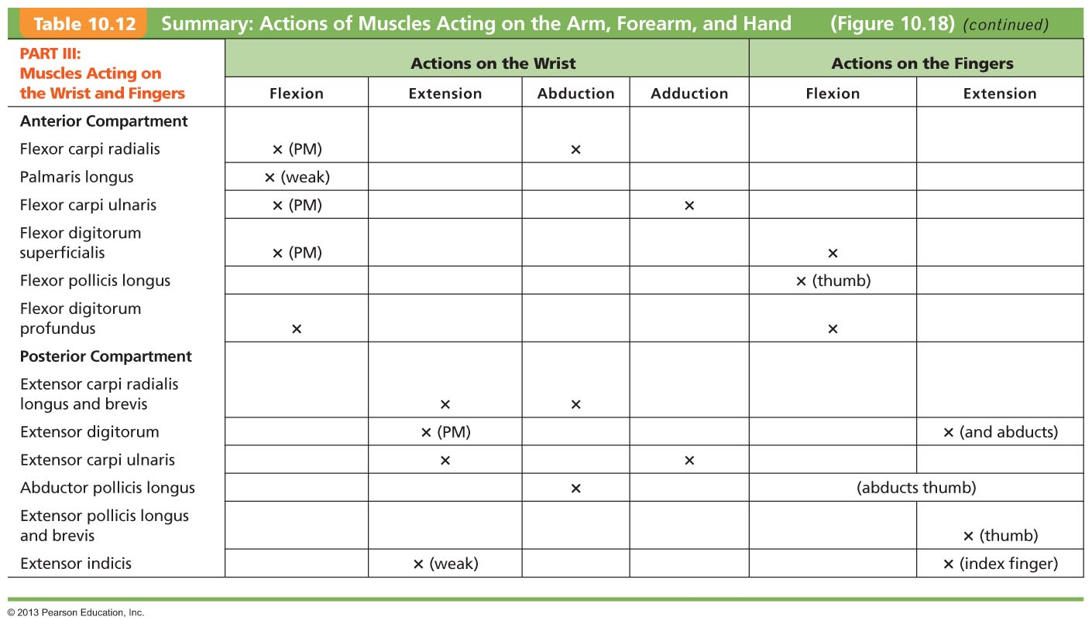
Table 10.12 Summary: Actions of Muscles Acting on the Arm, Forearm, and Hand (3 of 3)

Slide 37
Intrinsic Muscles of the Hand
Small weak muscles
  Lie entirely within palm of hand
  Control precise movements of metacarpals and fingers (e.g., threading a needle)
  Abductors and adductors of fingers
  Produce opposition—move thumb toward little finger

Slide 38
Finger and Thumb Movements
Flexion
  Thumb—bends medially along palm
  Fingers—bend anteriorly
Extension
  Thumb—points laterally
  Fingers—move posteriorly

Slide 39
Intrinsic Muscles of the Palm
Three groups
  Thenar eminence (ball of thumb)
  Hypothenar eminence (ball of the little finger)
    Each of above groups has flexor, abductor, and opponens muscle
  Midpalmar muscles – lumbricals and interossei extend fingers
  Interossei muscles also abduct and adduct fingers

Slide 40
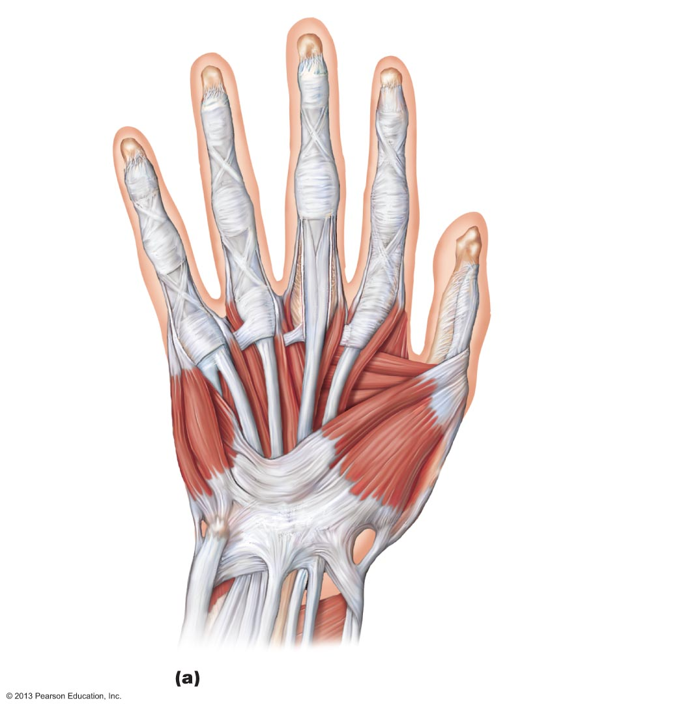
Figure 10.19a Hand muscles, ventral views of right hand.
Tendons of:
Flexor digitorum
profundus
Flexor digitorum
superficialis
Fibrous sheath
Second lumbrical
Third
lumbrical
Dorsal interossei
First lumbrical
Fourth
lumbrical
Adductor pollicis
Flexor pollicis
brevis
Opponens
digiti minimi
Abductor
pollicis
brevis
Flexor digiti
minimi brevis
Opponens
pollicis
Abductor
digiti minimi
Flexor
retinaculum
Pisiform bone
Abductor
pollicis
longus
Flexor carpi
ulnaris tendon
Tendons of:
Flexor digitorum
superficialis
tendons
Palmaris longus
Flexor carpi radialis
Flexor pollicis longus
First superficial layer

Slide 41
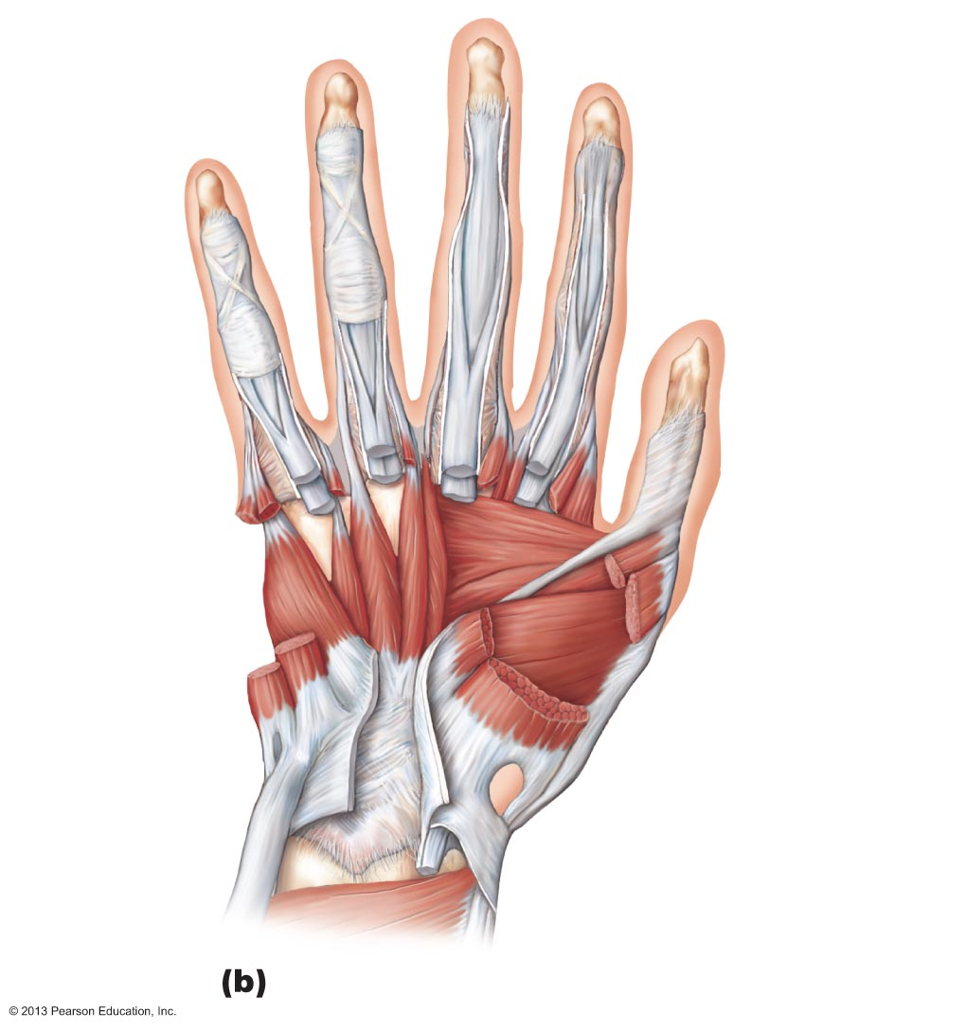
Figure 10.19b Hand muscles, ventral views of right hand.
Flexor digitorum
profundus tendon
Flexor
digitorum
superficialis
tendon
Dorsal
interossei
Palmar
interossei
Adductor
pollicis
Opponens
digiti minimi
Flexor
pollicis
brevis
Flexor digiti
minimi brevis
(cut)
Abductor
pollicis
brevis
Abductor
digiti minimi
(cut)
Opponens
pollicis
Flexor pollicis
longus tendon
Second layer

Slide 42
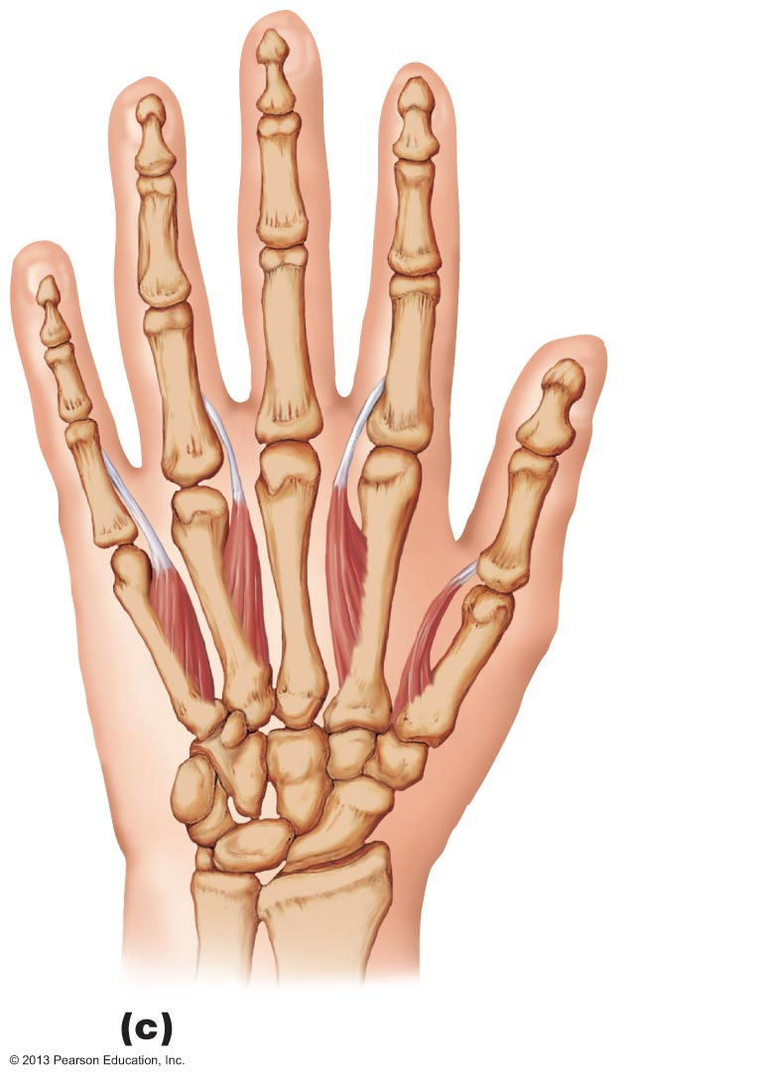
Figure 10.19c Hand muscles, ventral views of right hand.
Palmar
interossei
Palmar interossei (isolated)

Slide 43
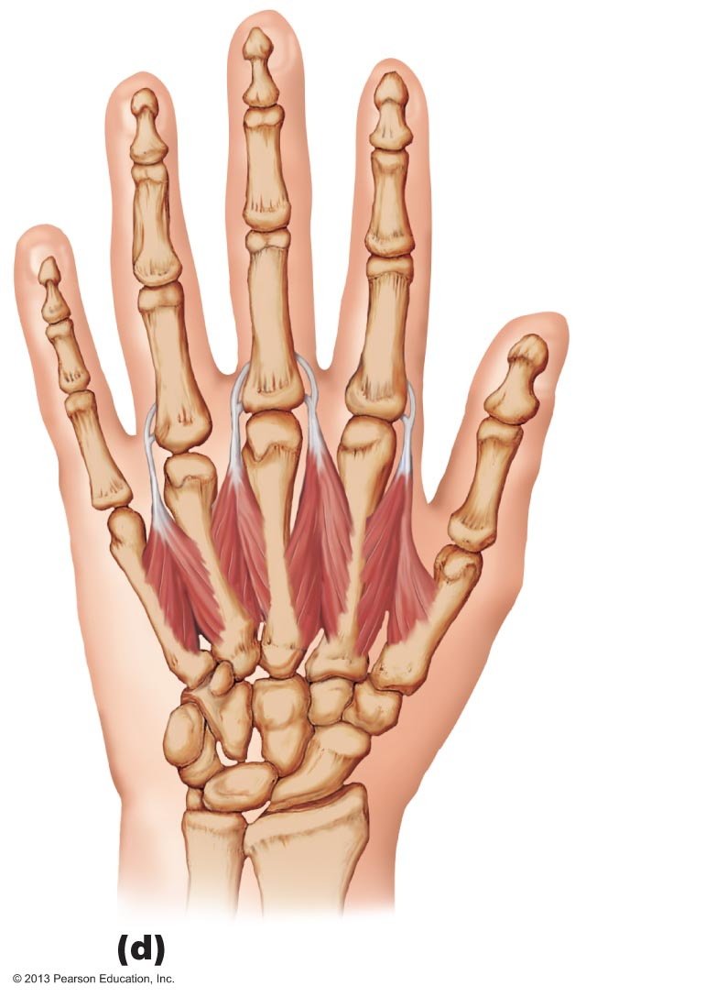
Figure 10.19d Hand muscles, ventral views of right hand.
Dorsal
interossei
Dorsal interossei (isolated)

Slide 44
Intrinsic Muscles of the Hand
PLAY
Animation: Rotating hand

